Slide 1
The embedded systems platform
Example: alarm clock

Slide 2
Alarm clock interface
Alarm on
Alarm off
buzzer
PM
Alarm
ready
light
set
time
set
alarm
hour
minute
button

Slide 3
Operations
Set time: hold set time, depress hour, minute.
Set alarm time: hold set alarm, depress hour, minute.
Turn alarm on/off: depress alarm on/off.

Slide 4
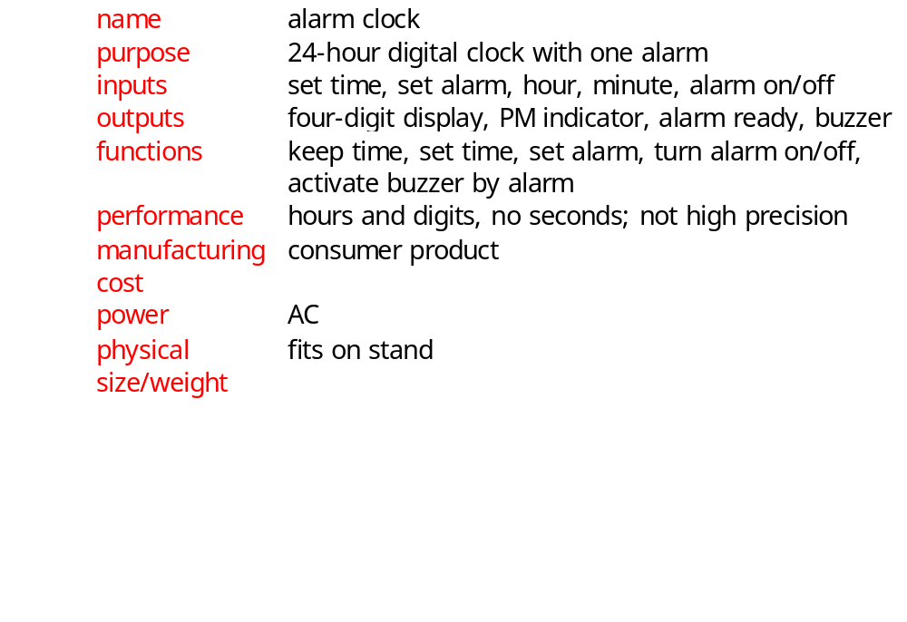
Alarm clock requirements

Slide 5
Alarm clock class diagram
1
1
1
1
Lights*
Display
Mechanism
1
1
1
Buttons*
Speaker*
1

Slide 6
Alarm clock physical classes
Lights*
Buttons*
Speaker*
digit-val()
digit-scan()
alarm-on-light()
PM-light()
set-time(): boolean
set-alarm(): boolean
alarm-on(): boolean
alarm-off(): boolean
minute(): boolean
hour(): boolean
buzz()

Slide 7
Display class
Display
time[4]: integer
alarm-indicator: boolean
PM-indicator: boolean
set-time()
alarm-light-on()
alarm-light-off()
PM-light-on()
PM-light-off()

Slide 8
Mechanism class
Mechanism
Seconds: integer
PM: boolean
tens-hours, ones-hours: boolean
tens-minutes, ones-minutes: boolean
alarm-ready: boolean
alarm-tens-hours, alarm-ones-hours:
boolean
alarm-tens-minutes, alarm-ones-minutes:
boolean
scan-keyboard()
update-time()

Slide 9
Update-time behavior
update seconds
with rollover
display.set-time(current time)
F
Rollover?
Time >= alarm and alarm-on?
F
T
update hh:mm
with rollover
T
alarm.buzzer(true)
PM->AM
AM->PM
PM=true
PM=false

Slide 10
Scan-keyboard behavior
Set-time and
not set-alarm
and hours
compute button activations
Alarm-on
Increment time
tens w. rollover
and AM/PM
alarm-ready=
true
Alarm-off
alarm-ready=
false
alarm.buzzer(false)
Increment time
ones w. rollover
and AM/PM
save button
states
Set-time and
not set-alarm
and minutes

Slide 11
System architecture
Includes:
  periodic behavior (clock);
  aperiodic behavior (buttons, buzzer activation).
Two major software components:
  interrupt-driven routine updates time;
  foreground program deals with buttons, commands.

Slide 12
Interrupt-driven routine
Timer probably can’t handle one-minute interrupt interval.
Use software variable to convert interrupt frequency to seconds.

Slide 13
Foreground program
Operates as while loop:
while (TRUE) {
read_buttons(button_values);
process_command(button_values);
check_alarm();
}

Slide 14
Testing
Component testing:
  test interrupt code on the platform;
  can test foreground program using a mock-up.
System testing:
  relatively few components to integrate;
  check clock accuracy;
  check recognition of buttons, buzzer, etc.

